Slide 1
Ν-Linearities and
Multiple View Tensors
Class 19
Multiple View Geometry
Comp 290-089
Marc Pollefeys

Slide 2
Content
Background: Projective geometry (2D, 3D), Parameter estimation, Algorithm evaluation.
Single View: Camera model, Calibration, Single View Geometry.
Two Views: Epipolar Geometry, 3D reconstruction, Computing F, Computing structure, Plane and homographies.
Three Views: Trifocal Tensor, Computing T.
More Views: N-Linearities, Multiple view reconstruction, Bundle adjustment, auto-calibration, Dynamic SfM, Cheirality, Duality

Slide 3
Multiple View Geometry course schedule
(subject to change)
Jan. 7, 9 | Intro & motivation | Projective 2D Geometry
Jan. 14, 16 | (no class) | Projective 2D Geometry
Jan. 21, 23 | Projective 3D Geometry | (no class)
Jan. 28, 30 | Parameter Estimation | Parameter Estimation
Feb. 4, 6 | Algorithm Evaluation | Camera Models
Feb. 11, 13 | Camera Calibration | Single View Geometry
Feb. 18, 20 | Epipolar Geometry | 3D reconstruction
Feb. 25, 27 | Fund. Matrix Comp. | Fund. Matrix Comp.
Mar. 4, 6 | Rect. & Structure Comp. | Planes & Homographies
Mar. 18, 20 | Trifocal Tensor | Three View Reconstruction
Mar. 25, 27 | Multiple View Geometry | MultipleView Reconstruction
Apr. 1, 3 | Bundle adjustment | Papers
Apr. 8, 10 | Auto-Calibration | Papers
Apr. 15, 17 | Dynamic SfM | Papers
Apr. 22, 24 | Cheirality | Project Demos

Slide 4
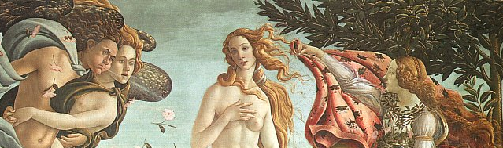
Multi-view geometry

Slide 5
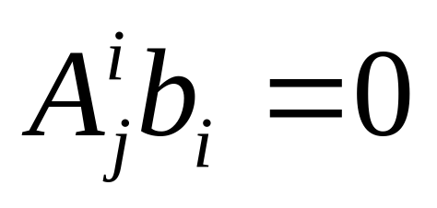
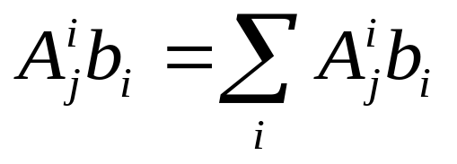
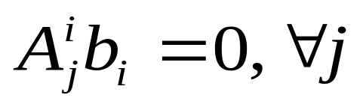
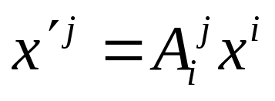
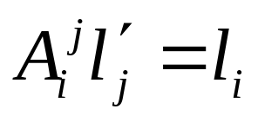
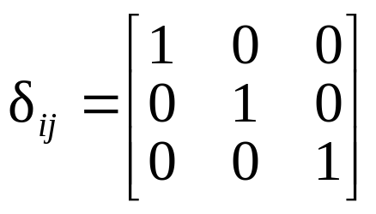
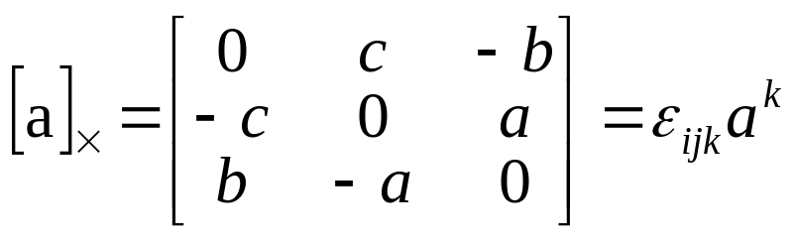
Tensor notation
Contraction:
(once above, once below)
Index rule:
Transformations:
(covariant)
(contravariant)
Kronecker delta
Levi-Cevita epsilon

Slide 6
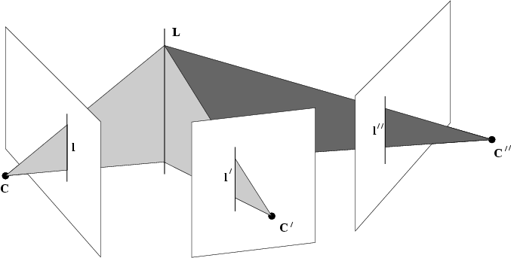
The trifocal tensor
Incidence relation provides constraint

Slide 7
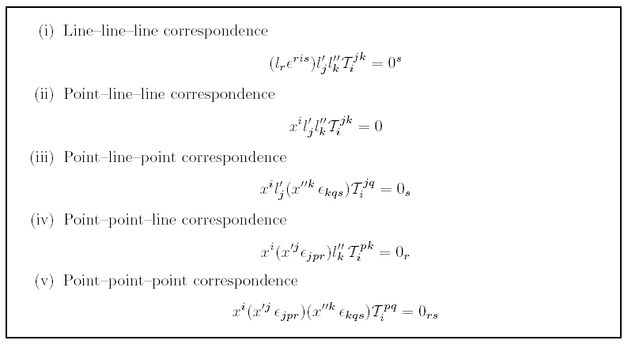
Trilinearities

Slide 8
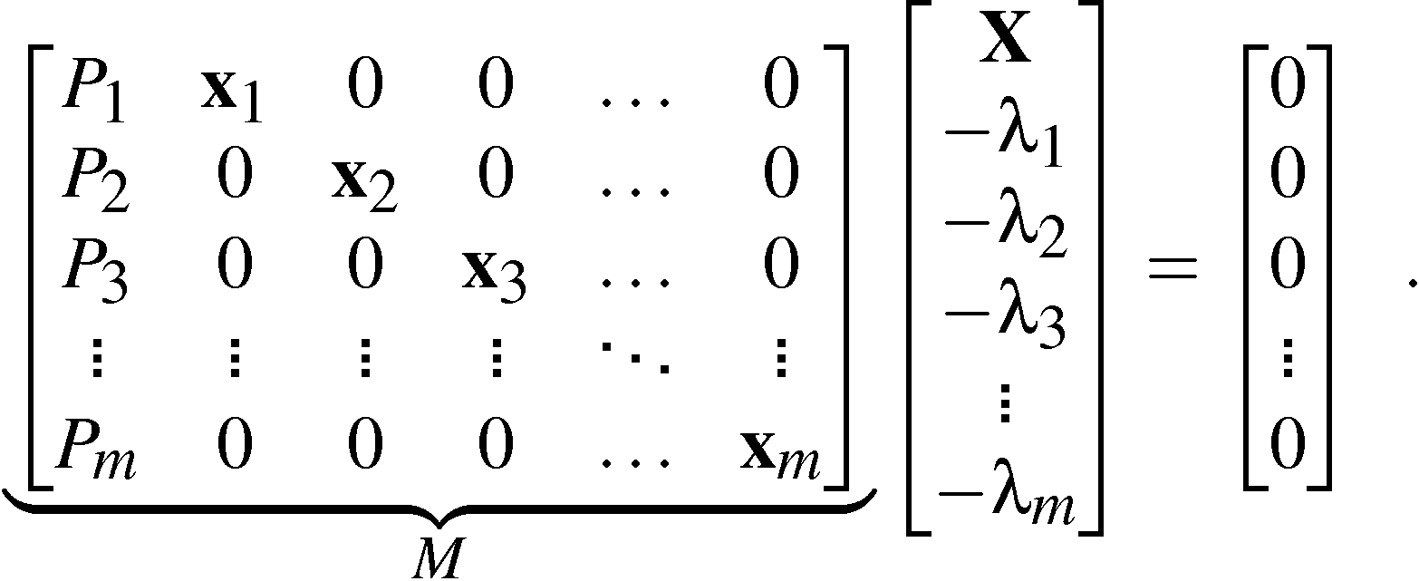
Matrix formulation
Consider one object point X and its m images: λ_{i}x_{i}=P_{i}X_{i}, i=1, …. ,m:
i.e. rank(M) < m+4 .

Slide 9
http://mathworld.wolfram.com/Determinant.html
http://mathworld.wolfram.com/DeterminantExpansionbyMinors.html

Slide 10
Laplace expansions
The rank condition on M implies that all (m+4)x(m+4) minors of M are equal to 0.
These can be written as sums of products of camera matrix parameters and image coordinates.

Slide 11
Matrix formulation
for non-trivially zero minors, one row has to be taken from each image (m).
4 additional rows left to choose

Slide 12
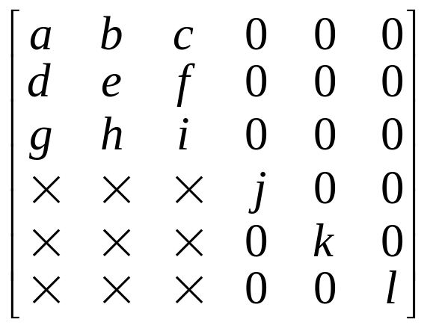
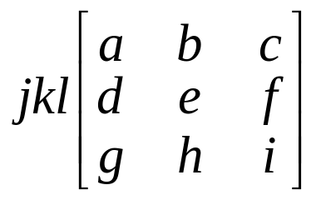
only interesting if 2 or 3 rows from view

Slide 13
The three different types
Take the 2 remaining rows from one image block and the other two from another image block, gives the 2-view constraints.
Take the 2 remaining rows from one image block 1 from another and 1 from a third, gives the 3-view constraints.
Take 1 row from each of four different image blocks, gives the 4-view constraints.

Slide 14
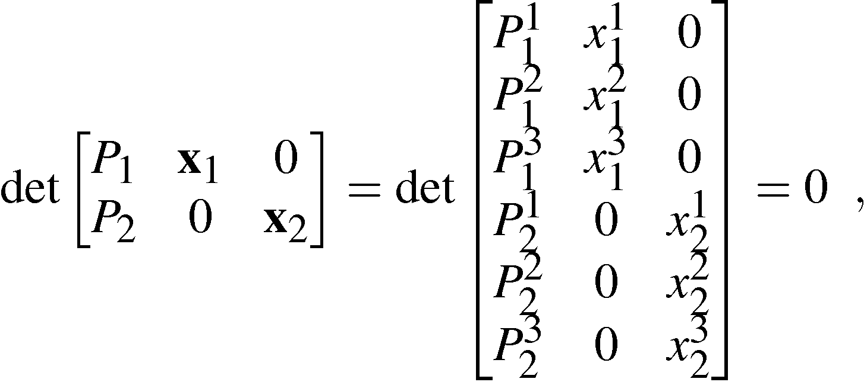
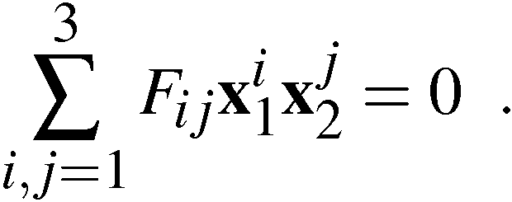
The two-view constraint
Consider minors obtained from three rows from one image block and three rows from another:
which gives the bilinear constraint:

Slide 15
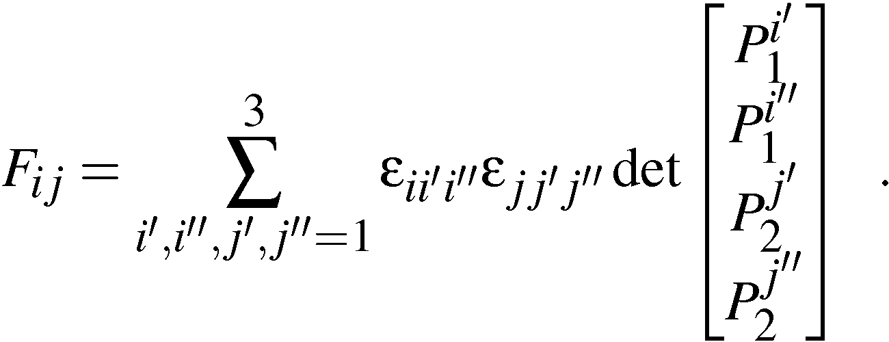
The bifocal tensor
The bifocal tensor F_{ij} is defined by
Observe that the indices for F tell us which row to exclude from the camera matrix.
The bifocal tensor is covariant in both indices.

Slide 16
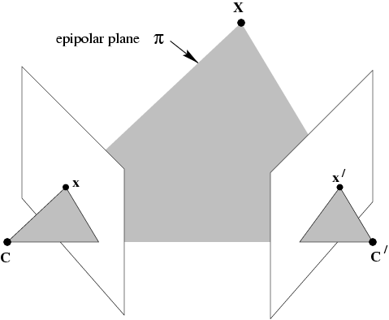
Geometric interpretation

Slide 17
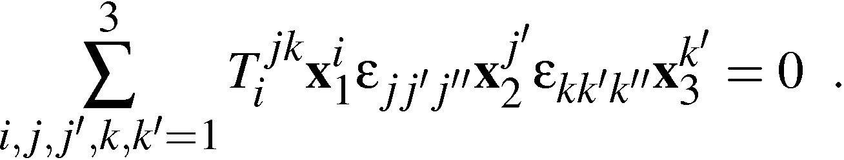
The three-view constraint
Consider minors obtained from three rows from one image block, two rows from another and two rows from a third:
which gives the trilinear constraint:

Slide 18
The trilinear constraint
Note that there are in total 9 constraints indexed by j’’ and k’’ in
Observe that the order of the images are important, since the first image is treated differently.
If the images are permuted another set of coefficients are obtained.

Slide 19
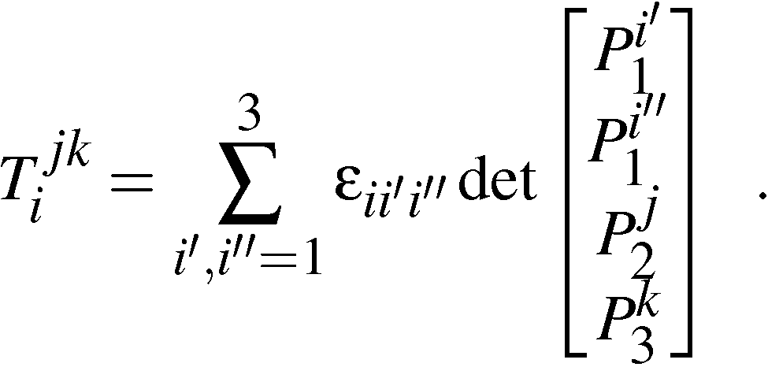
The trifocal tensor
The trifocal tensor T_{i}^{jk} is defined by
Observe that the lower indices for T tell us which row to exclude and the upper indices tell us which row to include from the camera matrix.
The trifocal tensor is covariant in one index and contravariant in the other two indices.

Slide 20
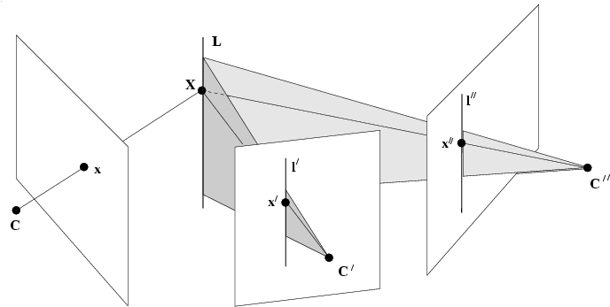
Geometric interpretation

Slide 21
The four-view constraint
Consider minors obtained from two rows from each of four different image blocks gives the quadrilinear constraints:
Note that there are in total 81 constraints indexed by i’’, j’’, k’’ and l’’ (of which 16 are lin. independent).

Slide 22
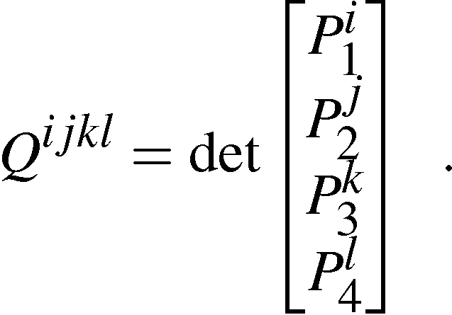
The quadrifocal tensor
The quadrifocal tensor Q^{ijkl} is defined by
Again the upper indices tell us which row to include from the camera matrix.
The quadrifocal tensor is contravariant in all indices.

Slide 23
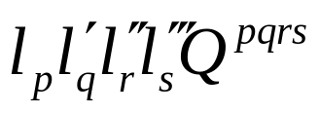
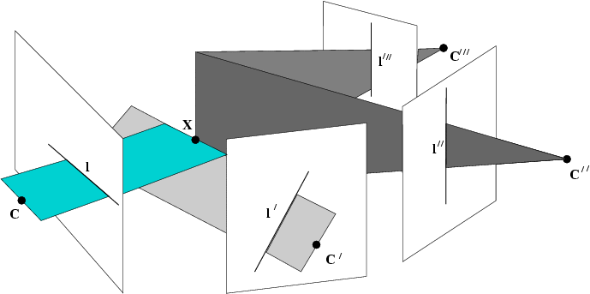
The quadrifocal tensor and lines

Slide 24
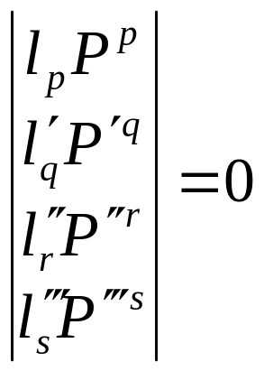
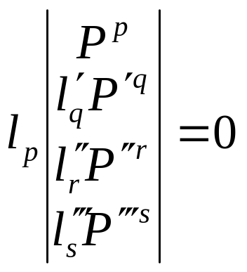
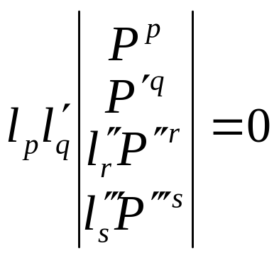
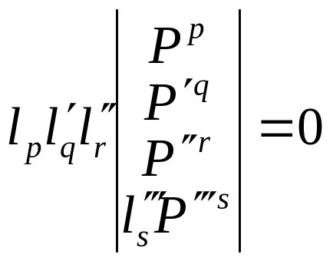
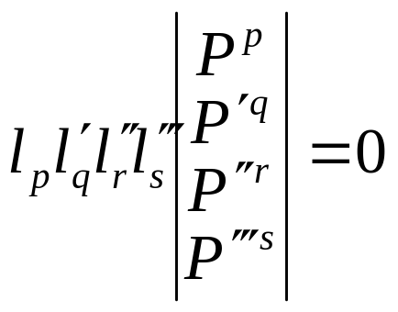
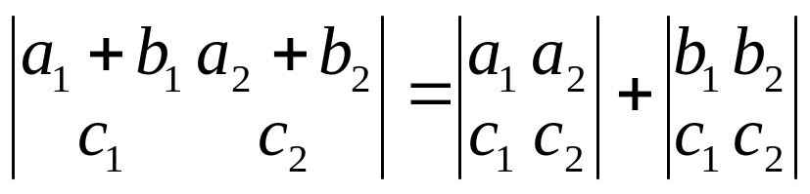
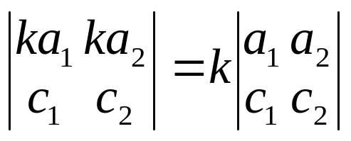
Intersection of four planes

Slide 25
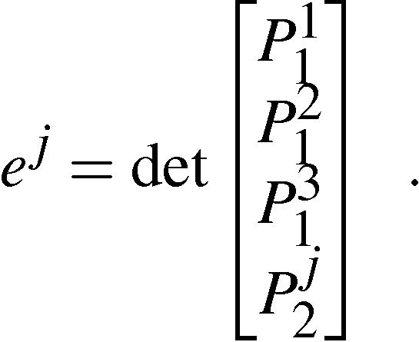
The epipoles
All types of minors of the first four rows of M has been used except those containing 3 rows from one image block and 1 row from another, i.e.
These are exactly the epipoles.

Slide 26


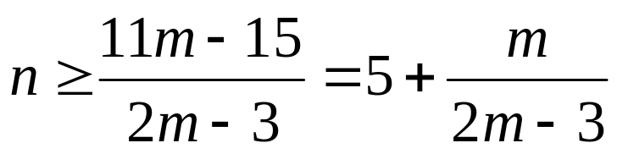
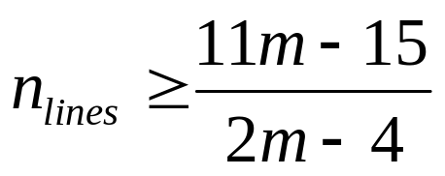
Counting argument

Slide 27
#views | tensor | #elem. | #dof | lin. #pts | lin. #lines | non-l. #pts | non-l. #lin
2 | F | 9 | 7 | 8 | - | 7* | -
3 | T | 27 | 18 | 7 | 13 | 6* | 9*?
4 | Q | 81 | 29 | 6 | 9 | 6 | 8*

Slide 28
Next class:
Project discussion

